Slide 1
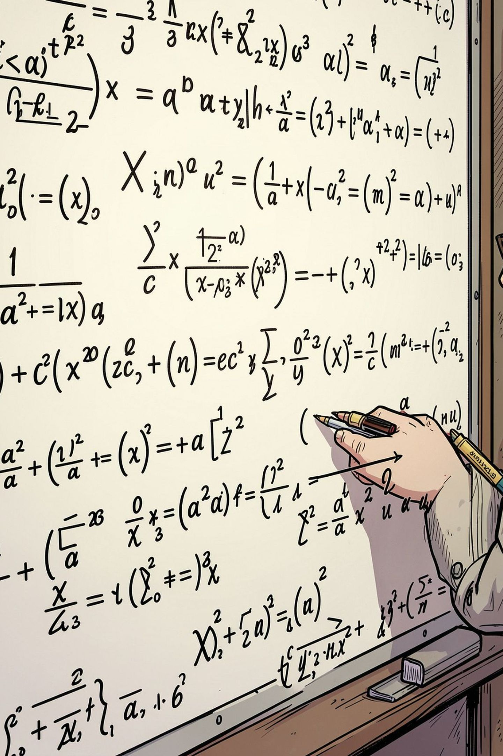
Handwritten Mathematical Symbol Recognition
A deep learning and image processing system for intelligent recognition of handwritten mathematical content — powering digital education, research, and automated document analysis.
AI · COMPUTER VISION · EDTECH

Slide 2
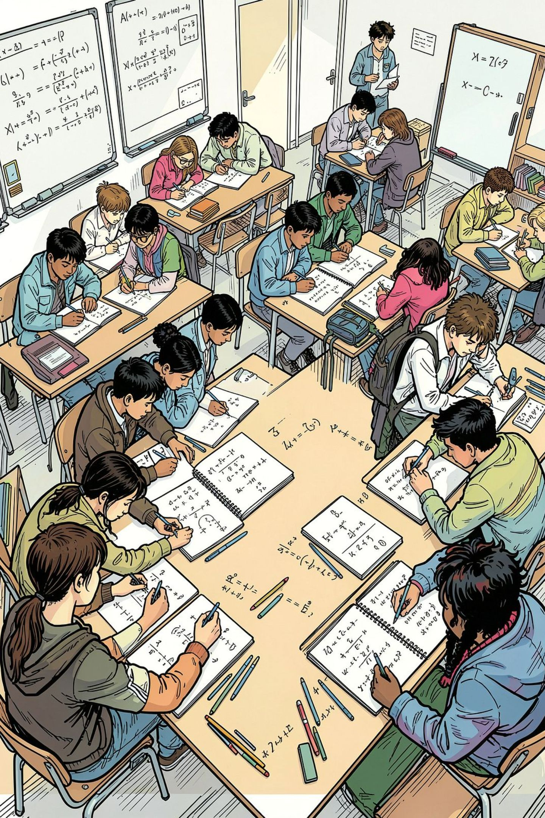
Why This Problem Matters
Digital Education
Convert handwritten math into searchable, interactive digital content for online learning platforms.
Automated Grading
Eliminate manual evaluation bottlenecks in examinations and assignment assessments.
Document Digitization
Preserve and index legacy scientific manuscripts, research papers, and textbooks.
Intelligent Tutoring
Enable real-time feedback systems that understand and respond to student handwriting.

Slide 3
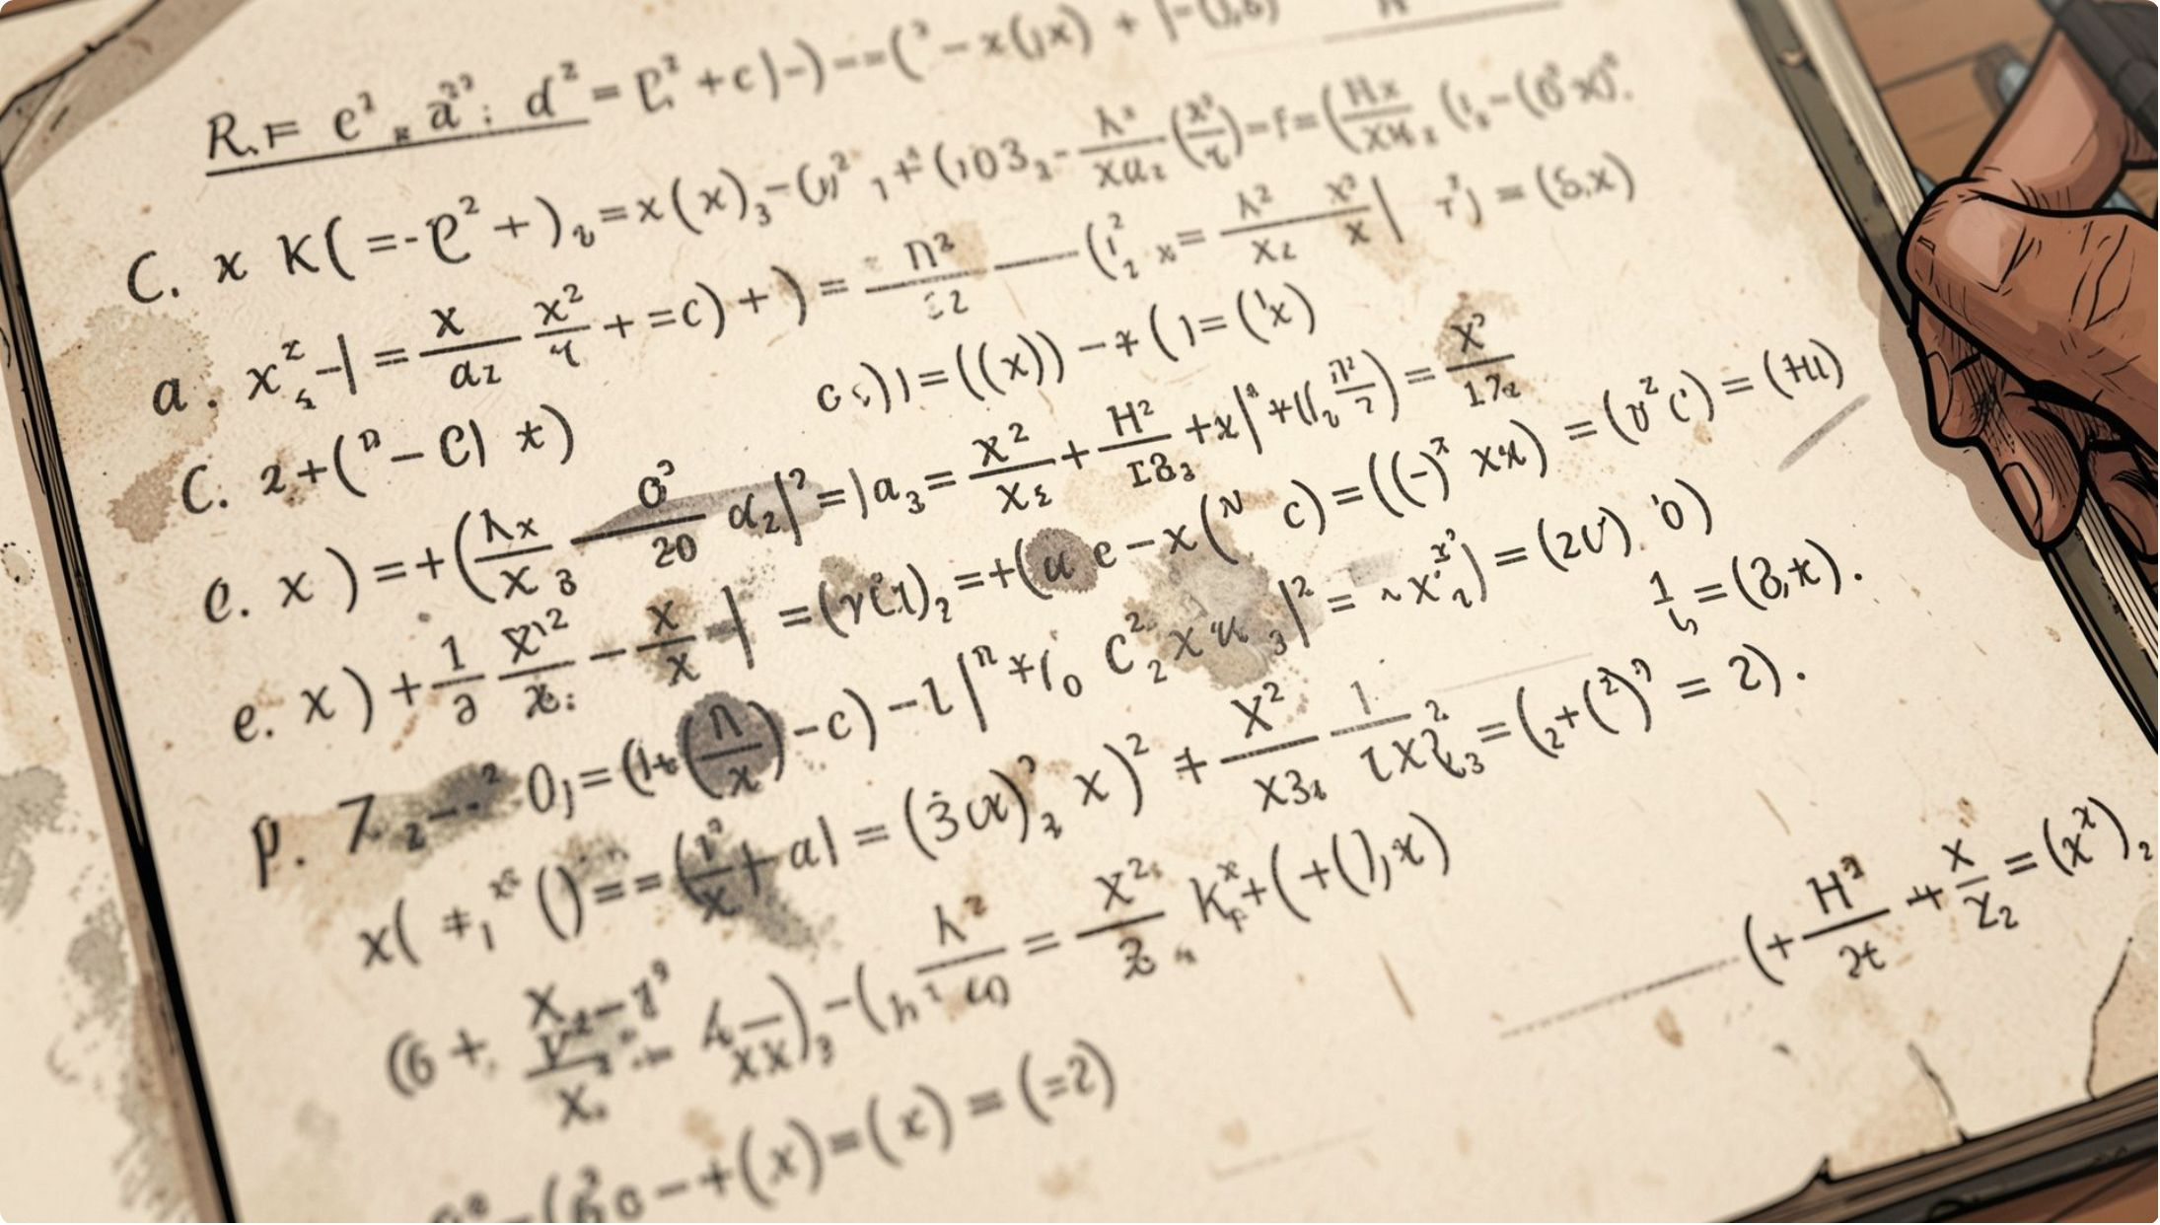

Where Traditional OCR Falls Short
Standard OCR engines are designed for printed text. Handwritten mathematics introduces a fundamentally harder set of challenges:
Style Variability
Complex Structures
Image Quality
Each writer forms symbols differently — loops, slants, and stroke widths vary widely.
Fractions, integrals, and subscripts create nested, overlapping spatial relationships.
Noise, shadows, low resolution, and skewed scans degrade recognition accuracy.

Slide 4
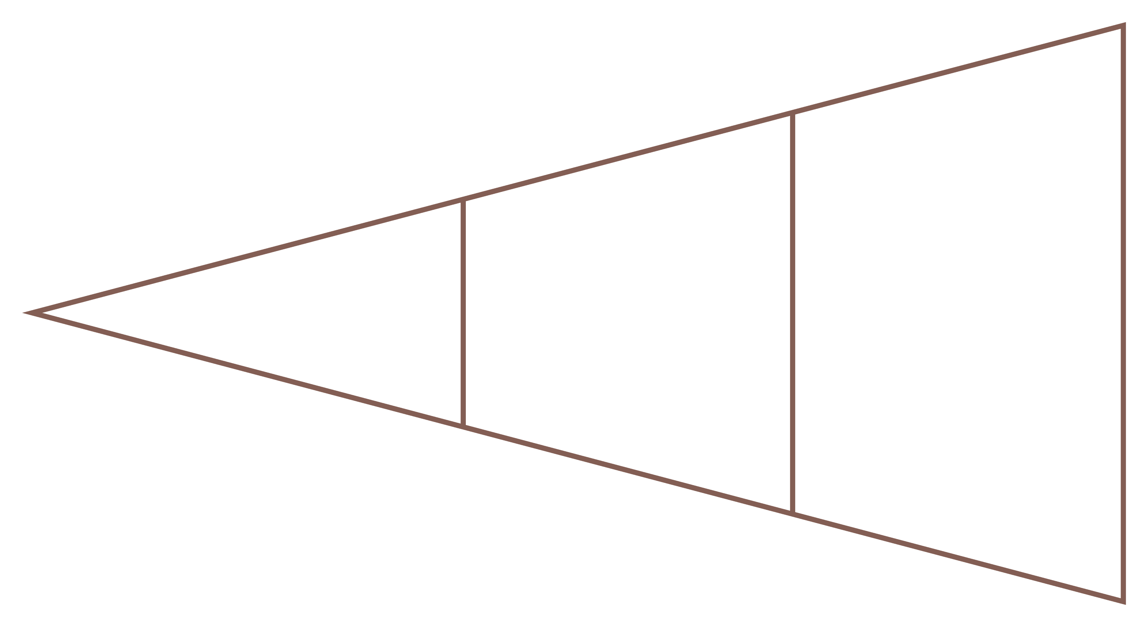
Proposed Solution: An Intelligent Recognition Pipeline
The system transforms a raw handwritten image into classified mathematical symbols with confidence scores through a structured, end-to-end pipeline.
Deep Learning Inference
Preprocess & Segment
Upload Image
Each stage is modular and independently optimizable, enabling continuous improvement without disrupting the full workflow.

Slide 5
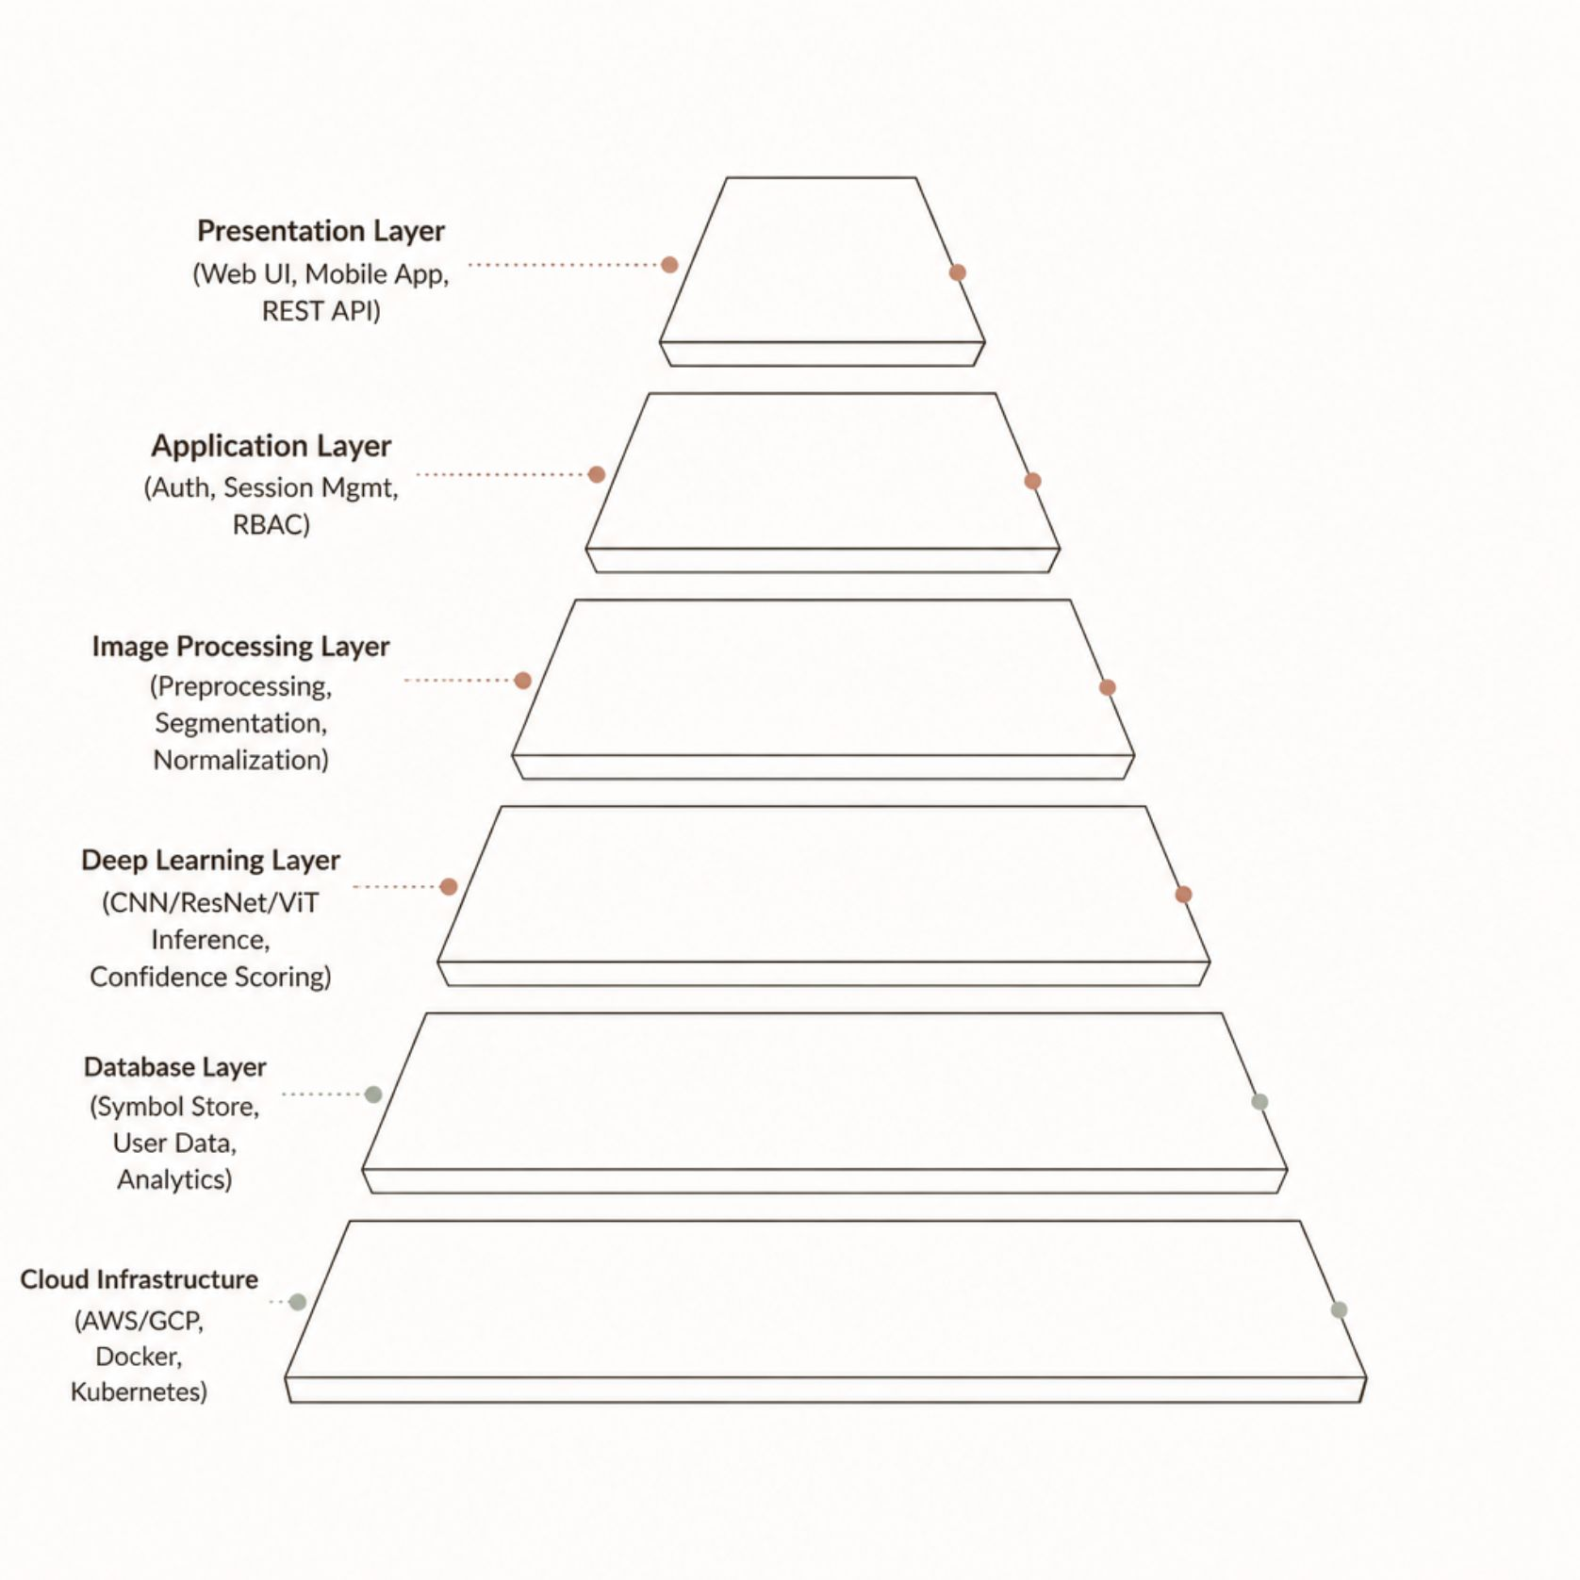
System Architecture
Layer-by-Layer Responsibility
The architecture separates concerns across six distinct layers, ensuring scalability, maintainability, and fault isolation.
Presentation Layer: React/Next.js frontend with responsive UI
Application Layer: Node.js/Python backend with JWT auth
Image Processing: OpenCV-based preprocessing engine
Deep Learning: TensorFlow/PyTorch inference serving
Database: PostgreSQL + Redis for caching
Cloud: Containerized deployment on AWS/GCP

Slide 6
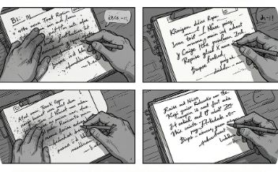
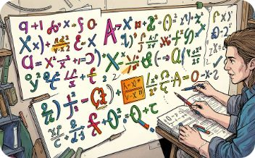
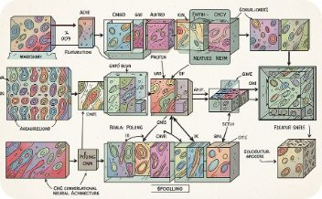
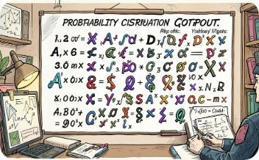
Image Processing & Deep Learning Methodology
Preprocessing
Segmentation
Feature Extraction
Classification
Grayscale conversion, Gaussian blur, adaptive thresholding, and morphological operations clean raw input images.
Connected component analysis and contour detection isolate individual symbols for classification.
CNN layers learn hierarchical spatial features — edges, curves, and structural patterns unique to each symbol.
ResNet, EfficientNet, or Vision Transformer models classify symbols with softmax confidence scores.

Slide 7
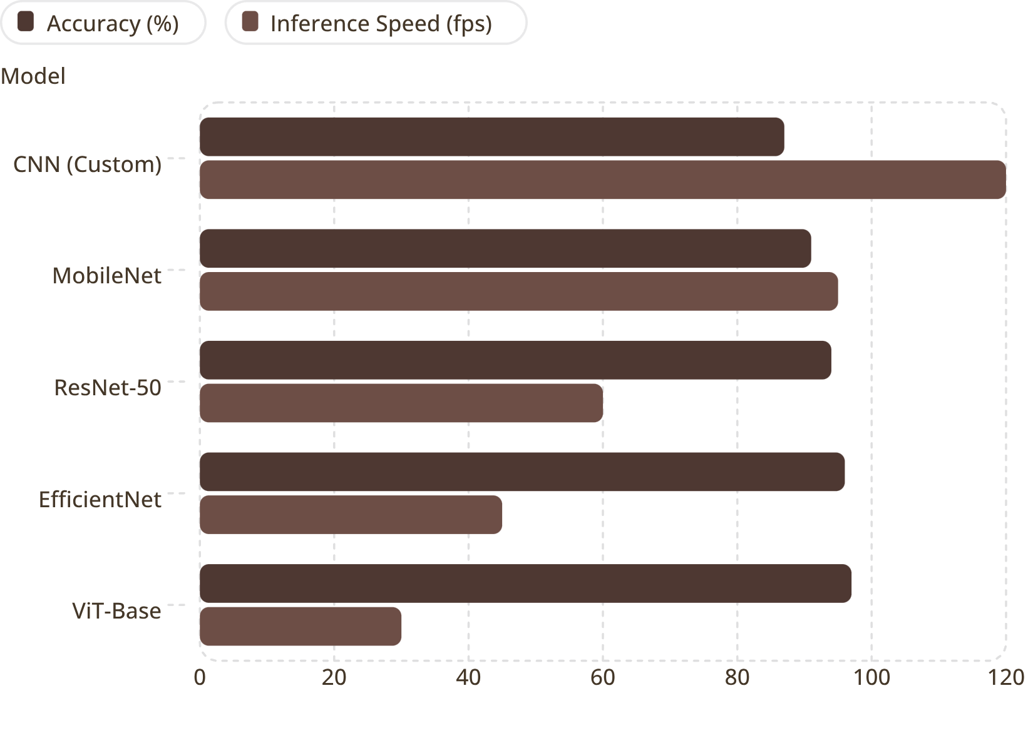

Model Selection & Performance
Choosing the Right Architecture
Model selection balances accuracy, latency, and deployment constraints. EfficientNet offers the best production trade-off for most use cases.
Evaluation Metrics
Continuous Learning
Accuracy, Precision, Recall, F1-Score, Confusion Matrix, and Inference Latency are tracked per symbol class.
Feedback loops retrain models on misclassified samples, improving accuracy over time.

Slide 8
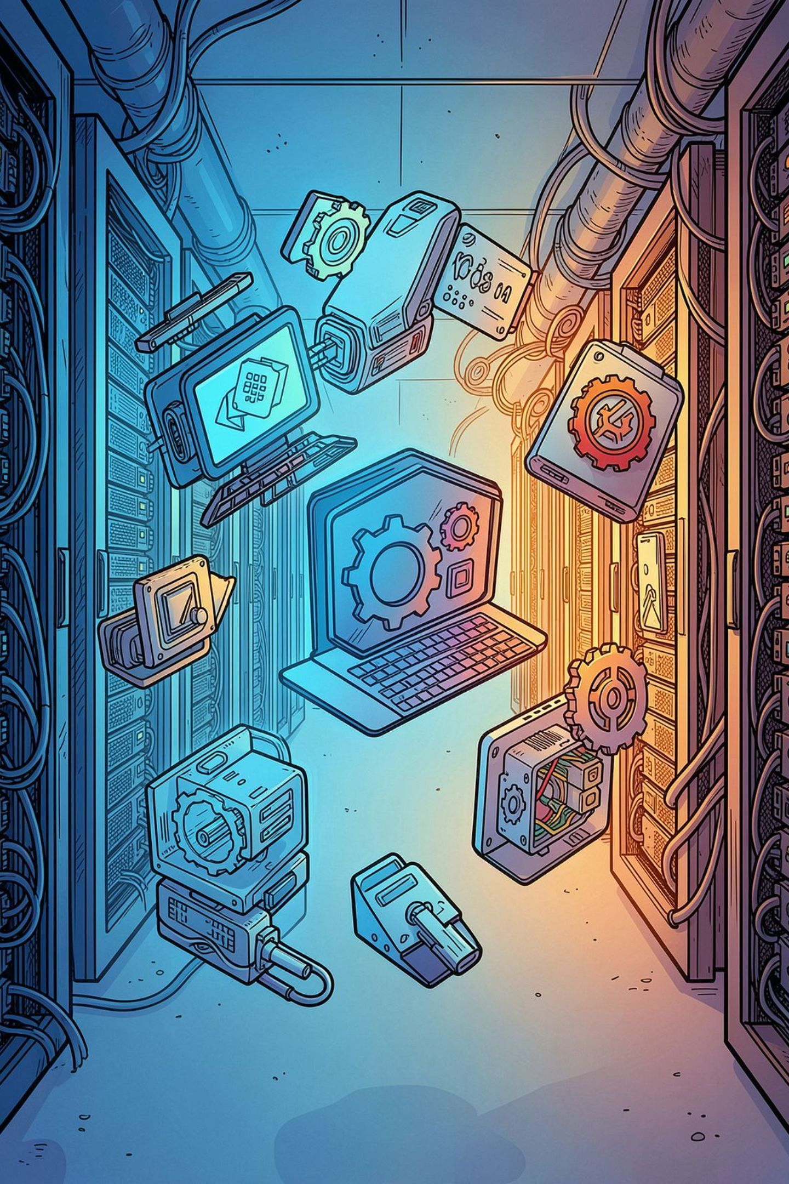




Technology Stack
Frontend
React.js / Next.js, D3.js for visualizations, responsive UI with Canvas API for image annotation.
Backend & APIs
Python FastAPI / Flask, RESTful APIs, JWT authentication, Celery for async task queues.
Deep Learning
TensorFlow / PyTorch, Keras, OpenCV, Albumentations for augmentation, ONNX for model export.
Infrastructure
PostgreSQL, Redis, Docker, Kubernetes, AWS S3 / GCP Cloud Storage, CI/CD via GitHub Actions.

Slide 9
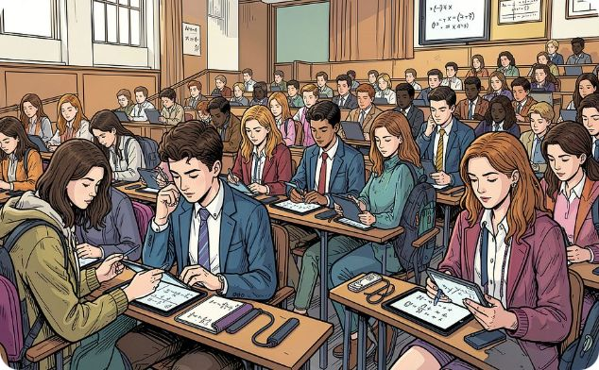


Real-World Applications
Academic Institutions
EdTech Platforms
Research & Publishing
Schools, colleges, and universities deploy the system for automated grading, digital note-taking, and examination processing.
Online learning platforms integrate recognition APIs to enable interactive problem-solving and real-time tutoring.
Scientific organizations and publishers use the system to digitize legacy manuscripts and build searchable equation databases.

Slide 10

Challenges, Future Roadmap & Conclusion
Current Challenges
Future Enhancements
Transformer-based vision models (ViT, Swin Transformer)
Full expression parsing with LaTeX generation
Multilingual mathematical notation support
Explainable AI for transparent recognition decisions
Mobile and edge AI deployment
Integration with digital whiteboards and AI tutors
Diverse Handwriting
Overlapping Symbols
Addressed via data augmentation and transfer learning on large, varied datasets.
Advanced segmentation using U-Net architectures and attention mechanisms.
Real-Time Performance
This system bridges handwritten mathematics and intelligent digital workflows — enabling scalable, accurate, and accessible math content recognition for education and research worldwide.
Edge AI deployment and model quantization reduce latency for live camera input.

